Slide 1
OSTEOARTHRITIS OF KNEE JOINT
Dr:Nishagopinath
Dept:of Practice of Medicine

Slide 2
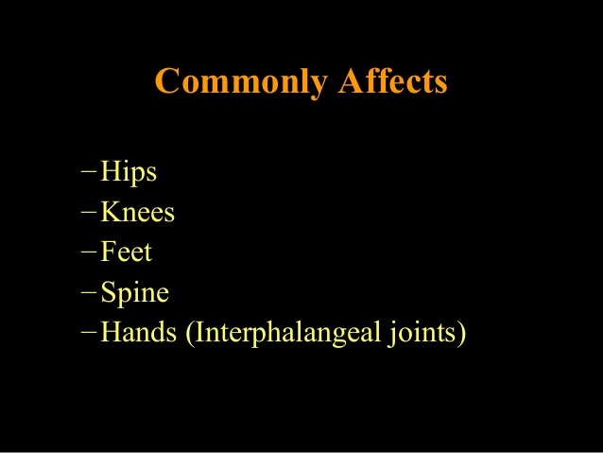
OSTEOARTHRITIS

Slide 3
KNEE JOINT
Also called as tibio femoral joint.it is formed by the
-medial and lateral condyles of distal end of femar.
- medial and lateral condyles of tibia.
- between the condyles ,inter condylar fossa provides space for the anterior crusiate ligament and posterior crusiate ligament.

Slide 4
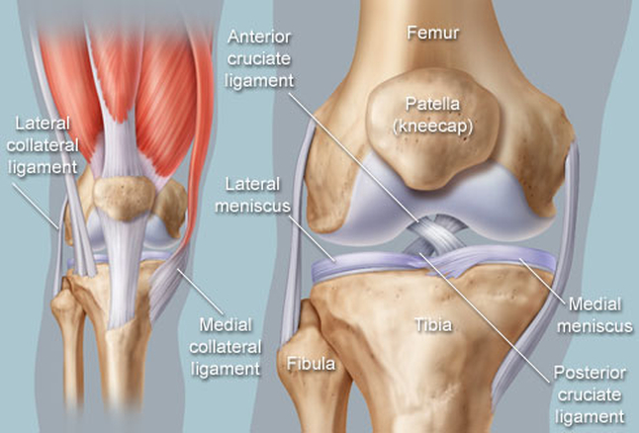
KNEE JOINT

Slide 5
Knee joint is a synovial hinge joint,formed between 3 bones ,FEMAR,TIBIA,and PATELLA.
Which allows flexion ,extension,and small degree of medial and lateral rotation.

Slide 6
Pathophysiology of OA knee
Pathophysiologic changes occurs in,
-articular cartilages
-synovial fluid
-underlying bone
-joint capsule

Slide 7
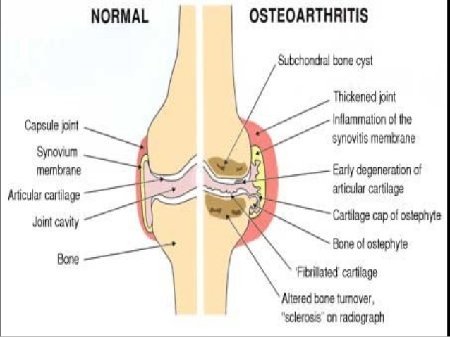

Slide 8
Changes in articular cartilage
Malfunctioning of chondrocytes
Cartilage become dehydrated and brittle.
Formation of cracks and fissures.
Loss of cartilage
Reduction of joint space

Slide 9
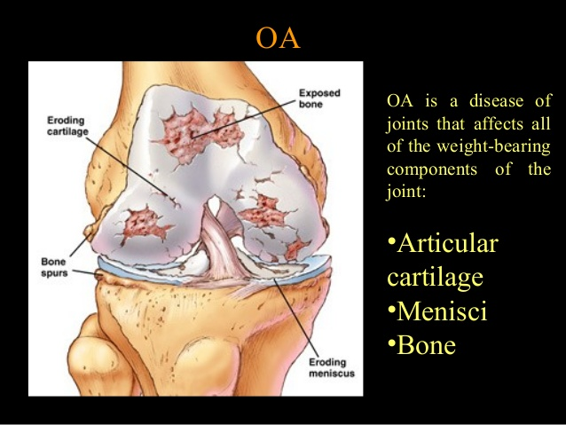

Slide 10
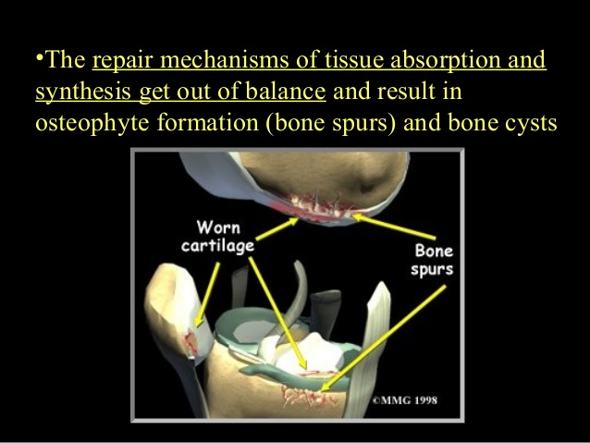

Slide 11
What causes the chondocytes to stop functioning????

Slide 12
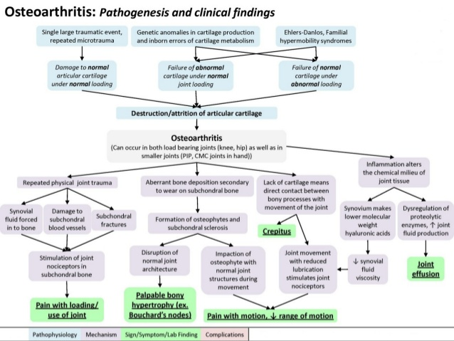
Notes:
SIGNS AND SYMPTOMS OF OA

Slide 13
COMPLICATIONS OF OA KNEE

Slide 14
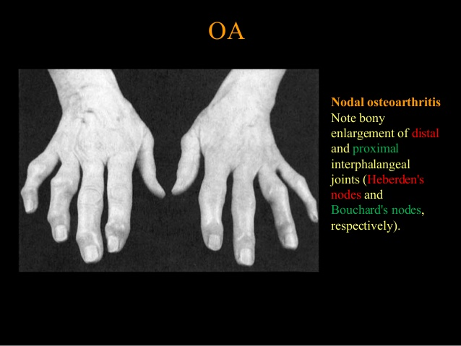

Slide 15
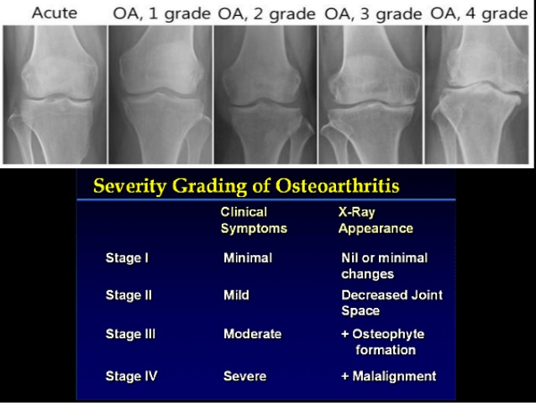

Slide 16
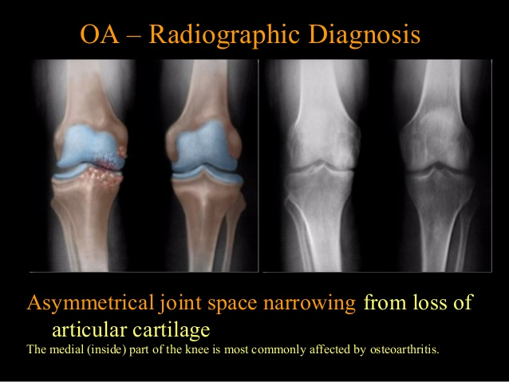

Slide 17
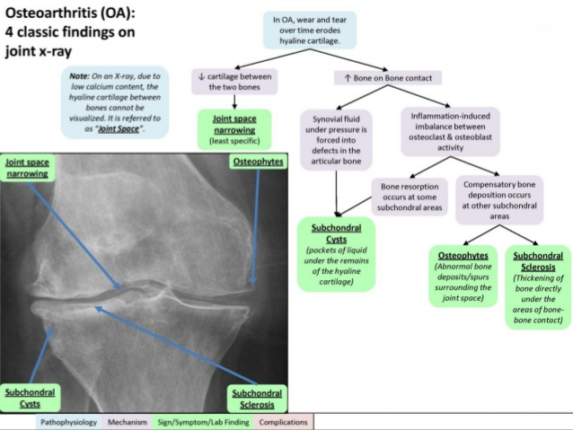

Slide 18
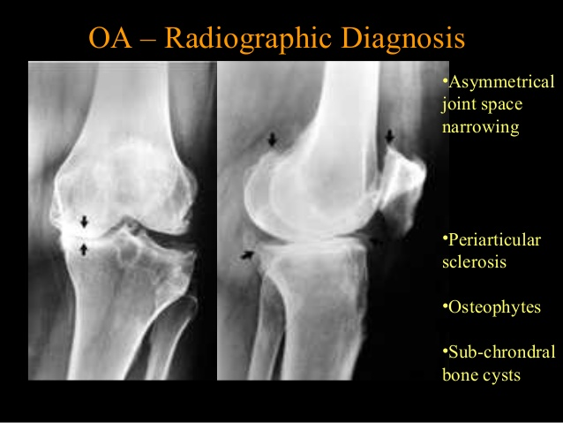

Slide 19
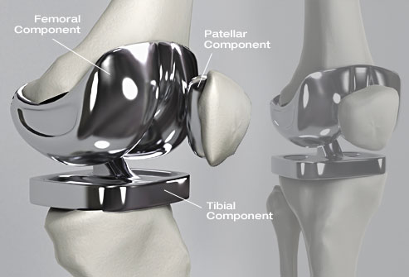
KNEE JOINT REPLACEMENT

Slide 20
KNEE JOINT REPLACEMENT

Slide 21
